Slide 1

Smart Object Detection and Proximity Alert System
This presentation explores the development of a smart object detection system, combining state-of-the-art computer vision technology with a proximity alert system, powered by the YOLOv8 model.

Slide 2
Introduction to Object Detection
The Basics
Real-World Applications
Object detection is a core computer vision task that identifies and locates objects within images or videos.
Object detection plays a crucial role in autonomous vehicles, robotics, security surveillance, and medical image analysis.

Slide 3
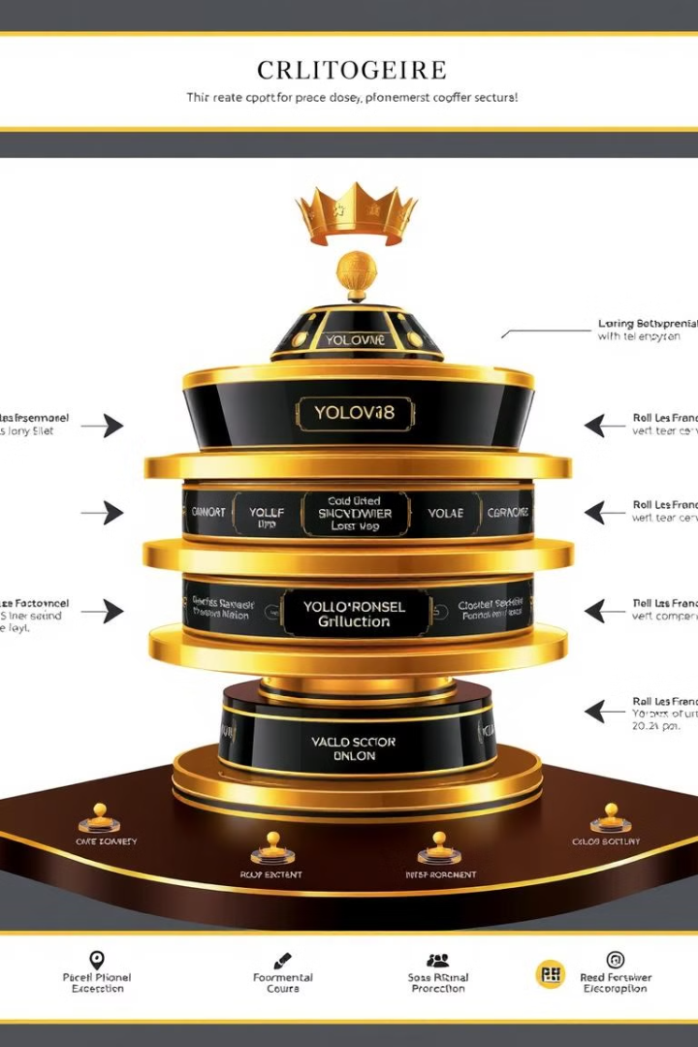
Overview of the YOLOv8 Model
1
1. YOLOv8's Strengths
2
2. Enhanced Performance
YOLOv8 is a cutting-edge object detection model known for its speed, accuracy, and versatility.
It significantly outperforms its predecessors in terms of both detection speed and accuracy.
3
3. Ease of Use
YOLOv8 is designed with a user-friendly interface and extensive documentation, making it accessible to developers.

Slide 4
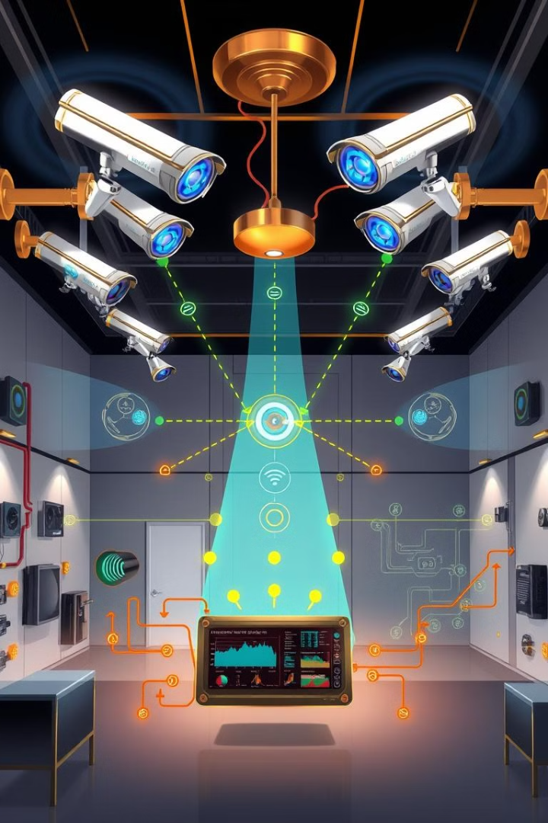
Object Detection and Proximity Alert System Applications
Security Systems
Autonomous Navigation
Enhance security by detecting unauthorized intrusions or suspicious activities and triggering alerts.
Enable vehicles or robots to perceive and navigate their surroundings safely.
Industrial Automation
Optimize industrial processes by detecting and tracking objects on production lines.

Slide 5




Addressing Challenges in Object Detection
Object Overlap
Real-Time Performance
Smart Alerts
Traditional methods struggle with overlapping objects, leading to inaccurate detections.
Achieving real-time detection with high accuracy poses significant challenges.
The need for dynamic and context-aware alerts based on proximity and other factors.

Slide 6
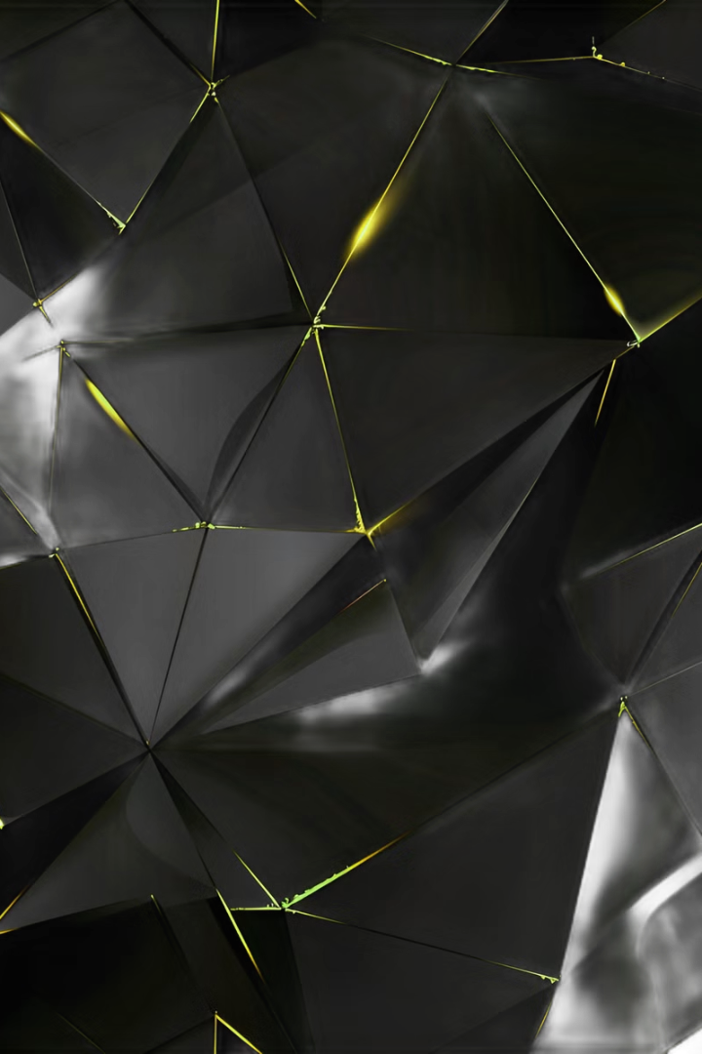
Implementing the Object Detection Algorithm
1
Step 1: Data Acquisition
Gathering and preparing a dataset of images for training the object detection model.
2
Step 2: Model Training
Training the YOLOv8 model on the prepared dataset to achieve high detection accuracy.
3
Step 3: Model Evaluation
Evaluating the trained model's performance using a separate validation dataset.

Slide 7




Technical Details: YOLOv8 Setup and Integration
Setup
Distance Calculation
Alarm Integration
Configure the YOLOv8 model and its parameters, including the desired object classes and detection thresholds.
Utilize object coordinates and camera parameters to calculate the distance between the detected objects and the camera.
Integrate an alarm system that triggers when a detected object crosses a predefined proximity threshold.

Slide 8

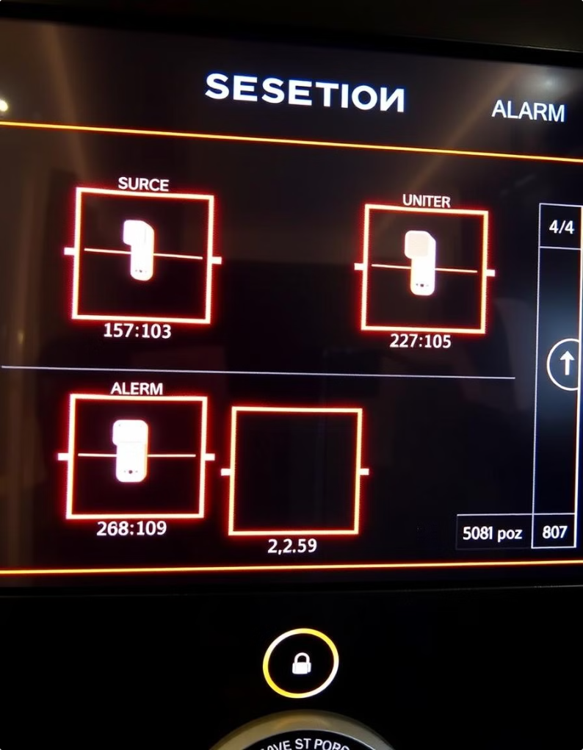
Outputs: Object Detection and Alarm Triggers
1
Bounding Boxes
Highlight detected objects with bounding boxes, indicating their location in the image.
2
Distance
Display the calculated distance between the detected object and the camera.
3
Alarm Trigger
Generate an alarm notification when the object crosses the proximity threshold.

Slide 9
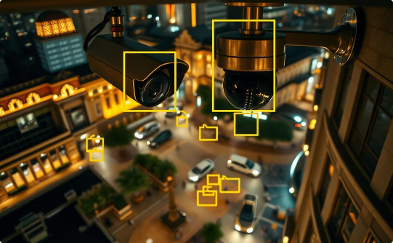
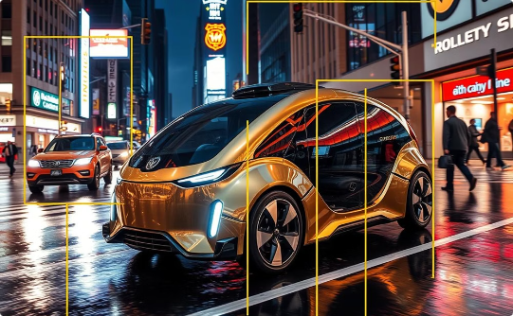
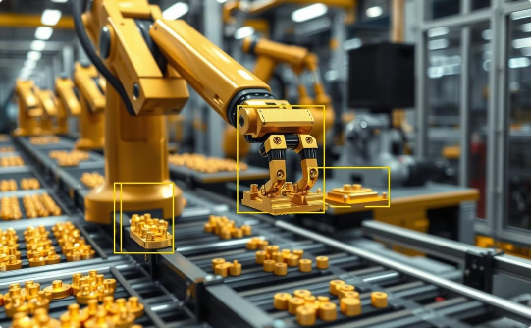
Real-World Use Cases
Security Surveillance
Autonomous Navigation
Industrial Automation
Monitor public spaces, identify potential threats, and enhance overall safety.
Enable vehicles to perceive their surroundings, avoid obstacles, and navigate safely.
Improve production efficiency by detecting and tracking objects on assembly lines.

Slide 10



Limitations and Future Opportunities
Current Limitations
1
The accuracy of object detection can be affected by environmental factors like lighting and weather.
Future Improvements
2
Further research in areas like sensor fusion and deep learning can enhance the system's capabilities.
Potential Impact
3
The system has the potential to revolutionize industries, from security and transportation to manufacturing.

